Slide 1

STEP COUNT AND YOUTUBE USAGE ANALYSIS
An analysis of the relationship between daily step count and the time spent watching YouTube videos in my exam periods..
ÇAĞDAŞ EYLEM AKSOY - 31985

Slide 2

MOTIVATION
Academic stress shapes our habits in unexpected ways. Through this project, I aimed to explore how exam periods influence my daily routines, from YouTube usage to physical activity.
Understanding these patterns helps me uncover the hidden connections between stress, productivity, and well-being. By reflecting on my habits, I hope to inspire healthier routines and encourage others to be mindful of their own behaviors during challenging times.

Slide 3
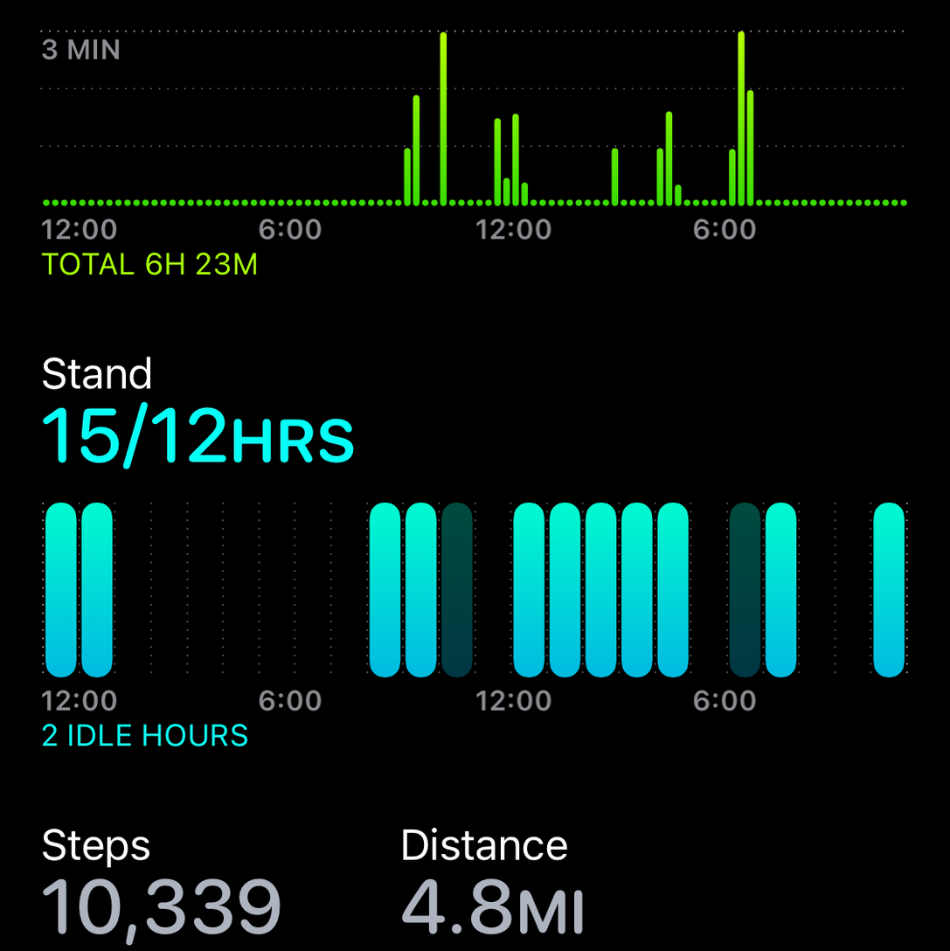


INTRODUCTION
Apple Health Step Count
YouTube Usage Data
Visualization methods
Analyzing the step count data from users' Apple Health app to understand their physical activity patterns.
Examining my usage on YouTube and the types of videos watched to understand my behaviors in and out of the exam periods.
Investigating the potential relationship between step count and YouTube usage to uncover insights about my behaviour when the exam comes.
By exploring the connection between physical activity and digital media consumption, this presentation aims to provide valuable insights into the overall well-being and lifestyle habits of me in the exam periods
.

Slide 4
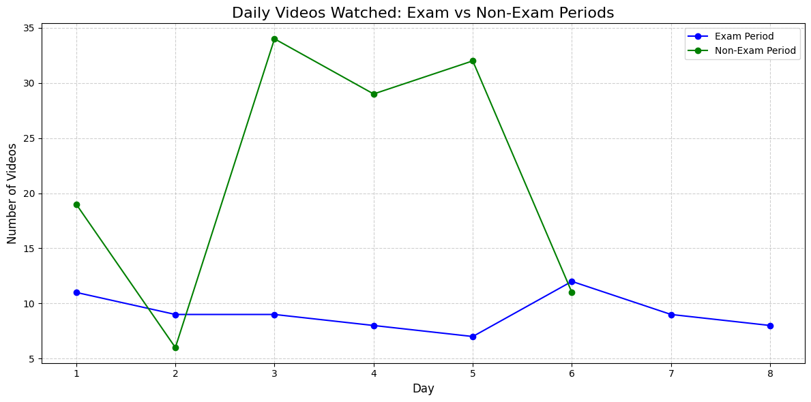
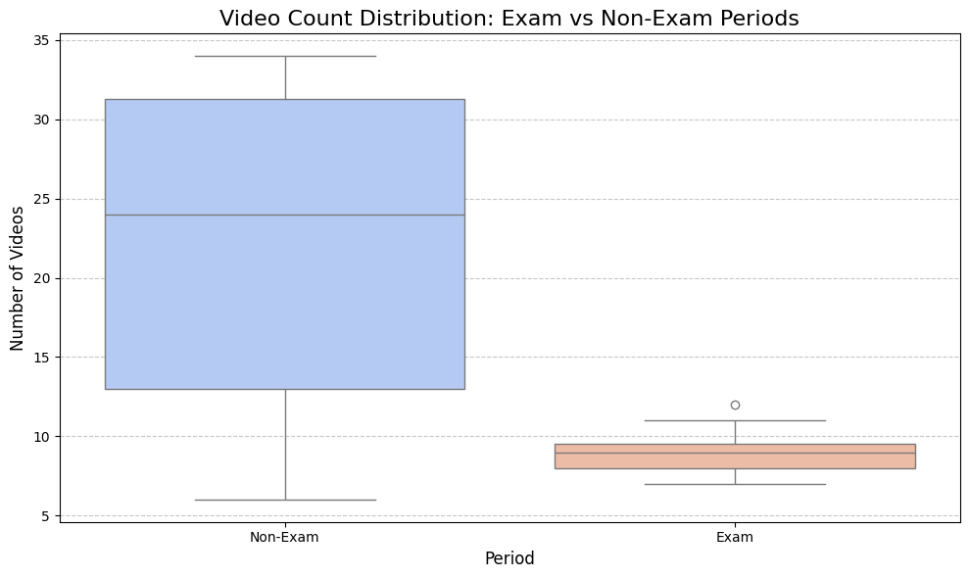
MY YOUTUBE USAGE
First,ı started with analyzing my YouTube usage data in the exam periods versus non-exam periods
Daily Videos Watched
Box-plot of the videos
from here,we can see that ı watched more videos when ı have not an exam.
Similarly,ı watched more videos in the non-exam period.

Slide 5
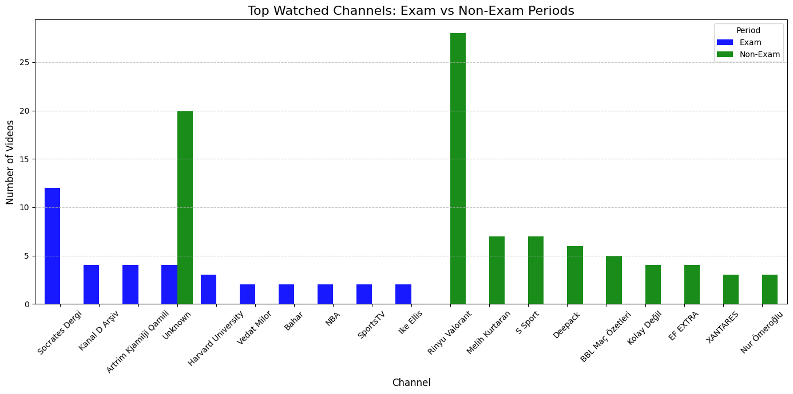
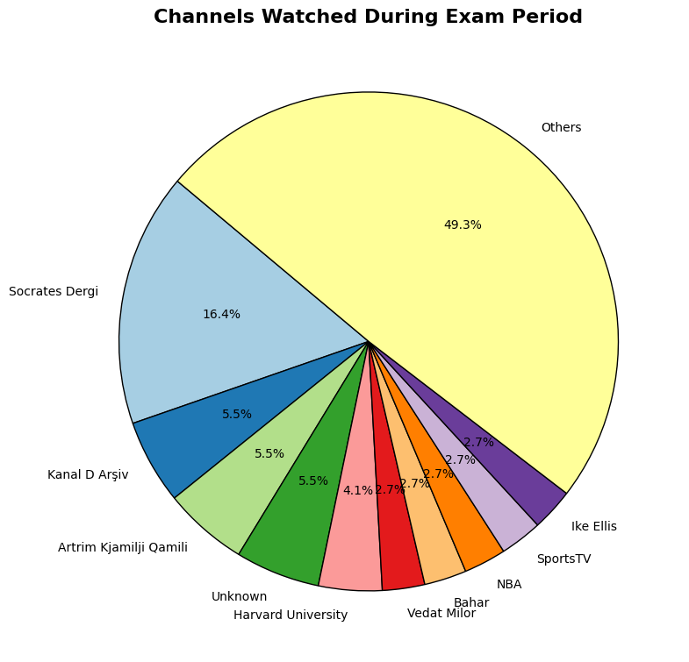
BUT,HOW ABOUT TYPES OF CONTENT
Top wached channels shows an unmeaningful distribution ,in other words there is no content difference.
Similarly,Socrates Dergi plays a big role in both exam and non-exam periods.

Slide 6
OVERALL OF YOUTUBE USAGE
Firstly,ı selected my exam period from my academic calendar and ı selected the non-exam period by randomly due to randomization rule for testing my hypothesis.
So,as seen in the previous 2 slides,my videos wathced in the exam weeks are decreasing but the type of content does not change so much.So lets dive to a deeper search with my apple health data.

Slide 7
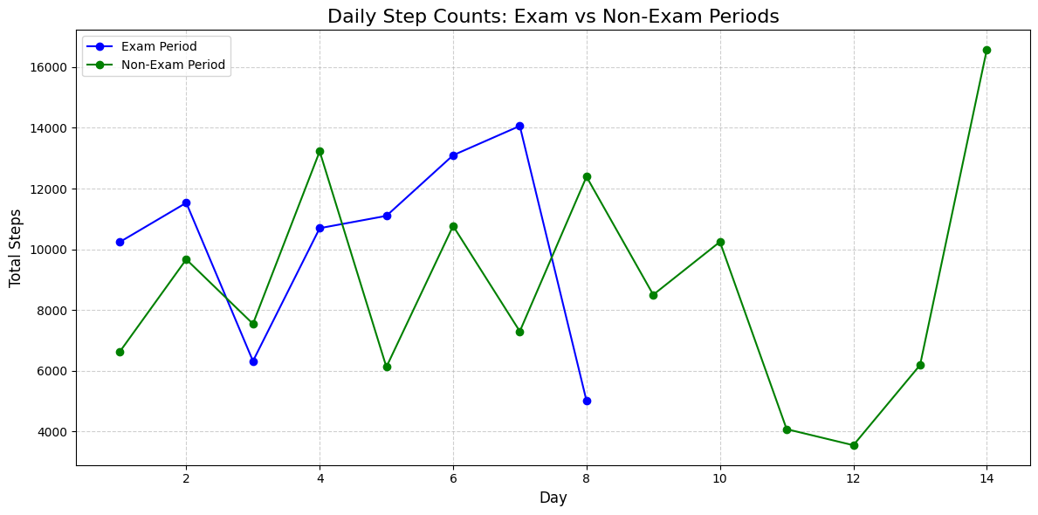
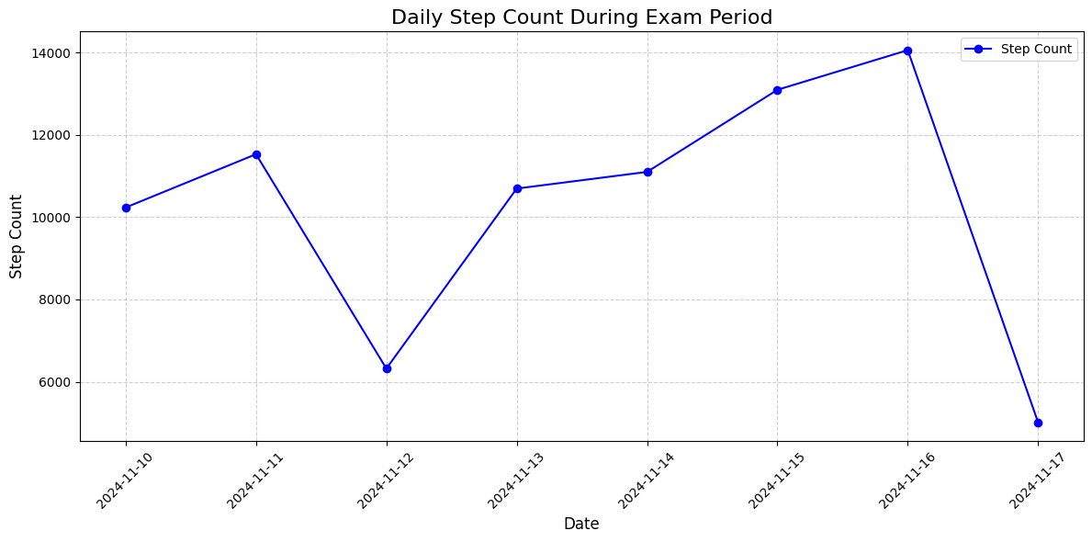
STEP COUNT DATA
The comparison of periods suggests there is similarity between them, but we cannot obtain anything from the comparison
From here, I want to emphasize that on 16 November, there is a peak, and that's the exam date of mine.

Slide 8
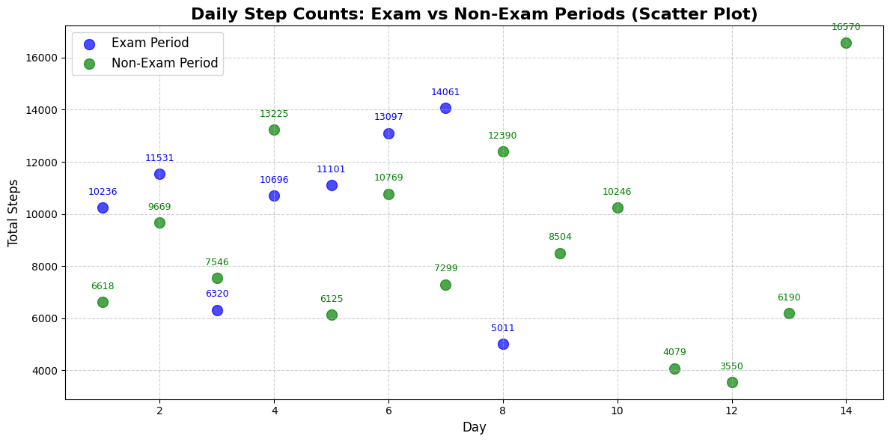
SEARCHING FOR RELATIONSHIP
There is no correlation between these two. I mean they are different. Step counts in non-exam periods tend to be lower in total. So this is a false argument about my physical activity decreasing in exam weeks.

Slide 9
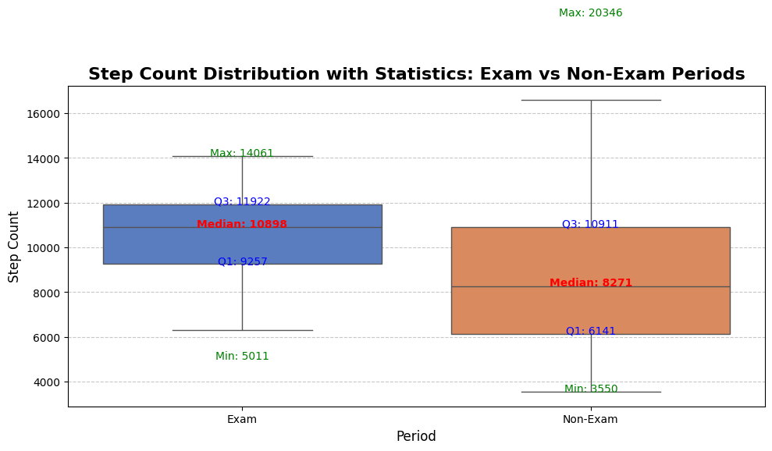
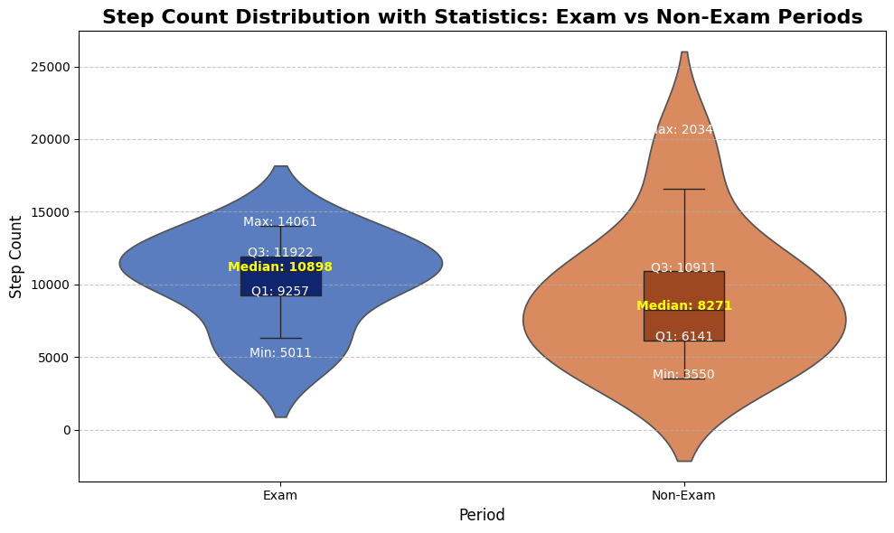
ADDITIONAL PLOTS FOR STATISTICS
The boxplot shows that physical activity actually increased during exam periods, which contradicts the initial expectation that it would decrease. The data appears to suggest the opposite trend to what was anticipated.
And that's the additional violin plot

Slide 10
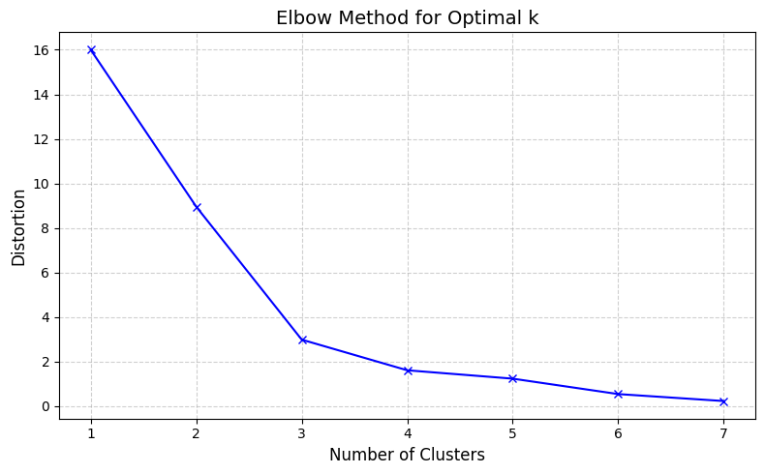
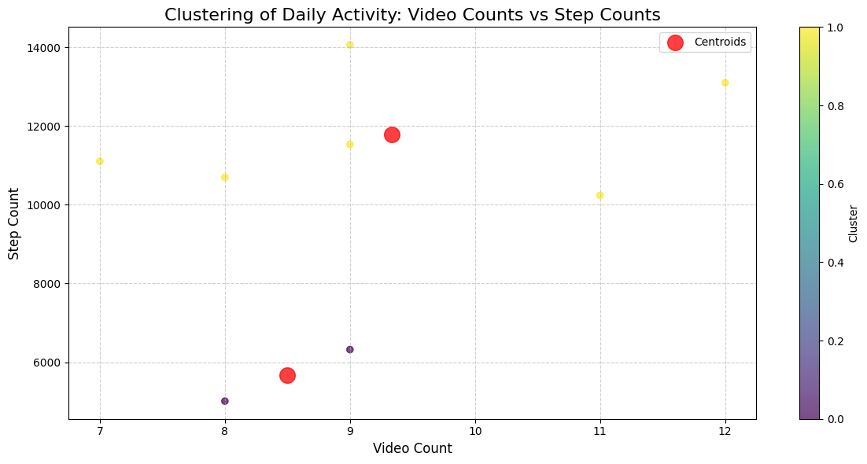
GOING FURTHER WITH MACHINE LEARNING
I came up with k-means clustering. With the elbow method, I found the optimal k and then I did a clustered plot.
The elbow plot indicates that the optimal number of clusters is around 3, as the distortion significantly reduces up to this point and flattens afterward. This suggests that segmenting the data into 3 groups captures the underlying structure effectively.
The scatter plot shows the clustering of daily activity based on video counts and step counts. Two distinct clusters are visible, with centroids marked in red. The clustering suggests distinct behavioral patterns in video watching and physical activity, potentially influenced by external factors like exam periods or personal habits.

Slide 11



CASUAL INFERENCE
I also did a casual inference.I calculated the Average Treatment Effect on Steps as -712.00.The causal inference analysis indicates a negative treatment effect, with an average reduction of 712 steps in the treatment group (those watching more than 10 videos daily) compared to the matched control group. This suggests that higher video consumption may be associated with decreased physical activity levels, highlighting a potential trade-off between screen time and physical activity.

Slide 12
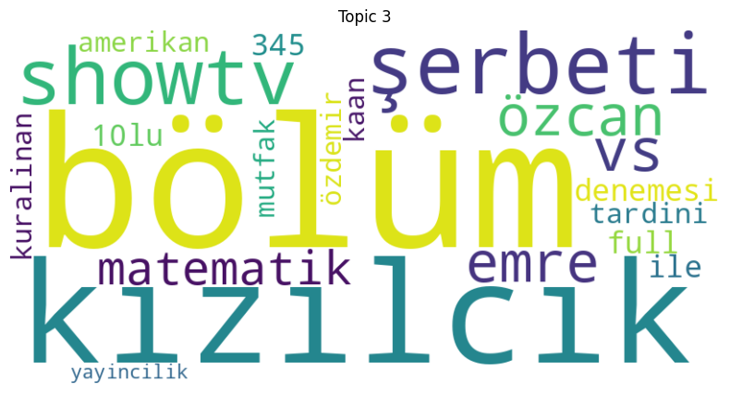
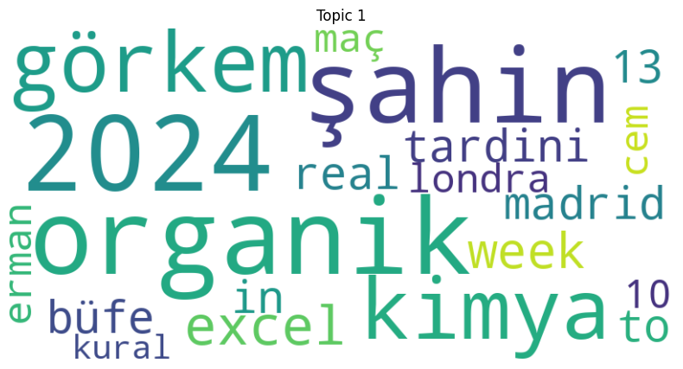
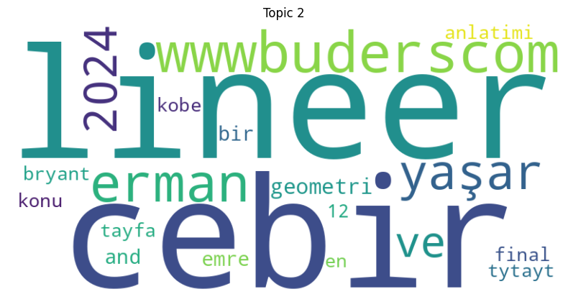
CONTENTS THAT I CONSUMING
Then, I did topic modeling which shows my most preferred contents. From here, I can make an assumption on whether my preferences change or not during the exam periods. Because, in the exams, maybe I can turn towards some motivational content in order to keep myself motivated.
Here, we can observe some entertainment videos that I watched.
In this topic, we can see some educational videos
And also here I watched mostly the educational stuff.

Slide 13
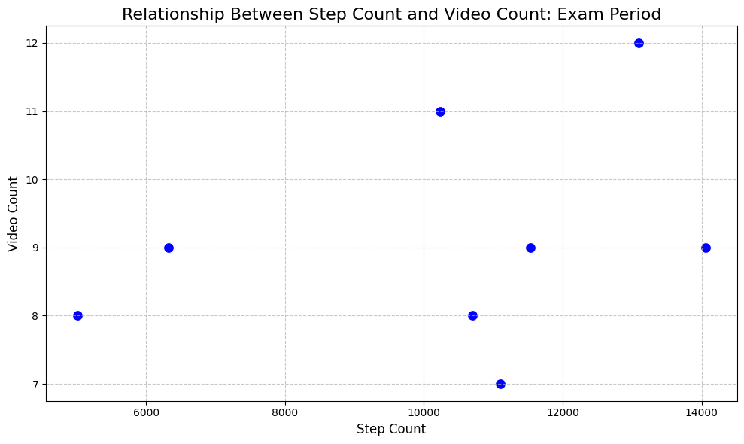
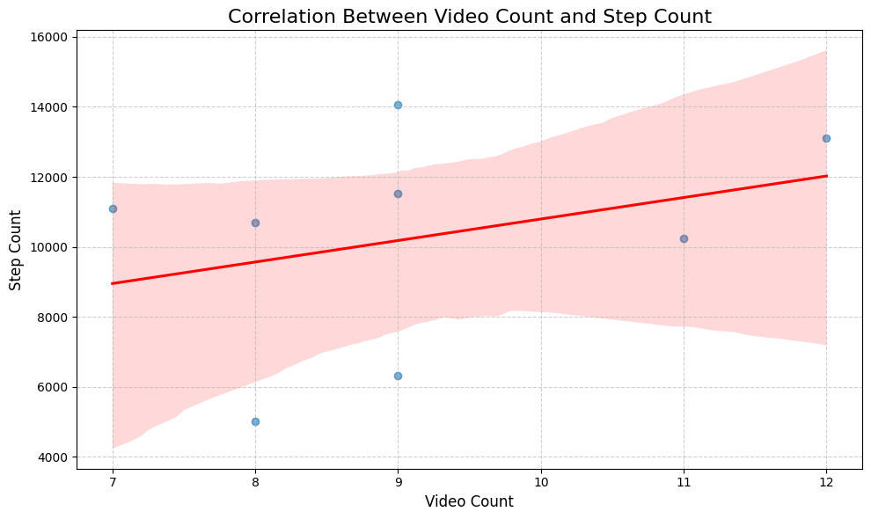
CORRELATION BETWEEN STEP COUNT AND YOUTUBE 📈
From here, we cannot see a strong correlation between step count and video count.
Although a weak positive trend is observed between video count and step count, the correlation is not statistically significant.

Slide 14
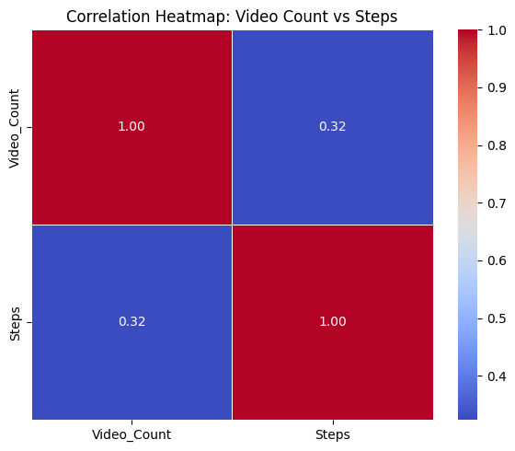
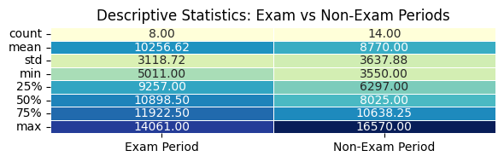
SOME ADDITIONAL STATISTICS AND CORRELATION HEATMAP
The corrected text is: The average step count (mean) is 10,256.62, which is higher than the Non-Exam period's average. The standard deviation values indicate that step counts are more consistent during the Exam period.
the correlation is 0.32,showing a weak positive relationship..

Slide 15
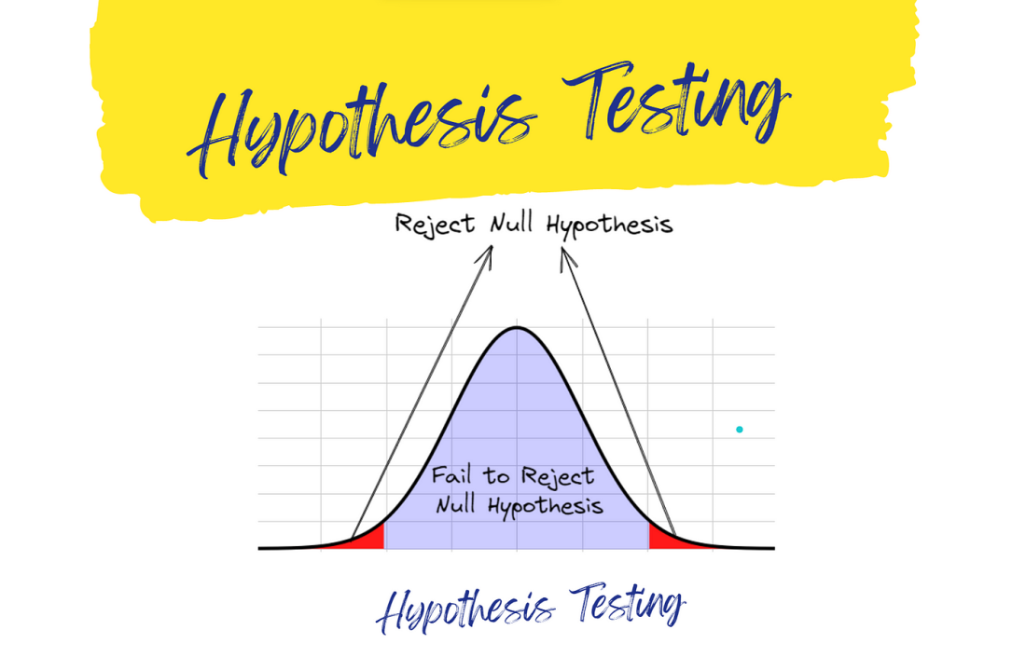
HYPOTHESIS TESTING
Defining the Hypothesis
So my hypothesis is:Null Hypothesis (H0​): There is no significant difference in daily step counts between Exam and Non-Exam periods.
Alternative Hypothesis (HA​): There is a significant difference in daily step counts between Exam and Non-Exam periods.
Selecting the Test Statistic
We selected the independent samples T-test because we are comparing the means of step counts between two independent groups (Exam and Non-Exam periods).
Determining the Significance Level
The significance level (αα) was set to 0.05, representing a 5% risk of rejecting the null hypothesis when it is true.

Slide 16
Calculatıng the test statistic
from scipy.stats import ttest_ind # Filter step counts for Exam and Non-Exam periods exam_steps = daily_steps[daily_steps['Period'] == 'Exam']['Steps'] non_exam_steps = daily_steps[daily_steps['Period'] == 'Non-Exam']['Steps'] # Perform T-Test t_stat, p_value = ttest_ind(exam_steps, non_exam_steps, equal_var=False) # Print the results print("T-Statistic:", t_stat) print("P-Value:", p_value) # Hypothesis test evaluation alpha = 0.05 # Significance level if p_value < alpha: print("Reject the null hypothesis") else: print("Fail to reject the null hypothesis")

Slide 17

RESULTS OF THE HYPOTHESIS TESTING
T-Statistic: 0.15387648286535555 P-Value: 0.8810481604744103 Fail to reject the null hypothesis
The p value is greater than the 0.05 so, we fail to reject the null hypothesis
Failing to reject the null hypothesis in this project indicates that there is no statistically significant difference in step counts between exam and non-exam periods. This suggests that academic stress during exams may not have a measurable impact on physical activity levels, at least in terms of daily step counts. While this result doesn't support the hypothesis, it highlights the complexity of behavioral patterns and the need for further investigation with additional factors."

Slide 18



FINDINGS ON THE PROJECT
The analysis revealed that the hypothesis—that academic stress during exams significantly impacts physical activity and YouTube usage—was not supported by the data. The T-test showed no statistically significant difference in step counts between exam and non-exam periods, suggesting that my physical activity levels remained relatively stable. Similarly, content preferences on YouTube, such as entertainment versus educational videos, did not show a meaningful shift during exam weeks. Cluster analysis further indicated no clear patterns linking video counts to step counts. While these findings did not confirm the expected relationship, they provided valuable insights into the stability of my habits during stressful periods. This project demonstrated the importance of data-driven investigations, even when outcomes challenge initial assumptions.

Slide 19




LIMITATIONS AND FUTURE WORK
This project had some limitations that may have affected the results. First, the data only covered a short period, which might not show long-term patterns or seasonal changes in behavior. Second, the process of categorizing genres and content was done manually, which could introduce some errors or biases. Also, the analysis mainly used basic statistical methods and could be improved with more advanced machine learning techniques to find deeper patterns or relationships.In the future, the project could be expanded by using data from a longer period, adding extra information like mood or activity logs, and applying real-time analysis. Using advanced methods like causal analysis or time-series forecasting could also provide better insights into how external factors impact personal habits. Overall, this project helped me appreciate the potential of data science to understand behavior, and it has motivated me to keep learning and improving my skills in this exciting field.

Slide 20

Thank you all for your time and attention! I truly appreciate your interest in my project. I hope it sparked some curiosity and inspired new ideas. It’s been a pleasure sharing this journey with you! 😊

